Slide 1
“FOOD HUB”
salish Kumar cs181046 nasir khalil cs181005 saqib hashim cs181012

Slide 2
wHAT IS FOODHub ?
This is a Food-Ordering application. Idea was inspired from FoodPanda. It will help people
Order Food any time at any place. In such circumstances as COVID-19, as
Social distancing is necessary, the idea of dining at Restaurant is dangerous, with
this app can order your favorite food at your door step.

Slide 3
Technologies
Android Studio
Flutter
PHP
MySQL
Shared preferences/Local Storage

Slide 4
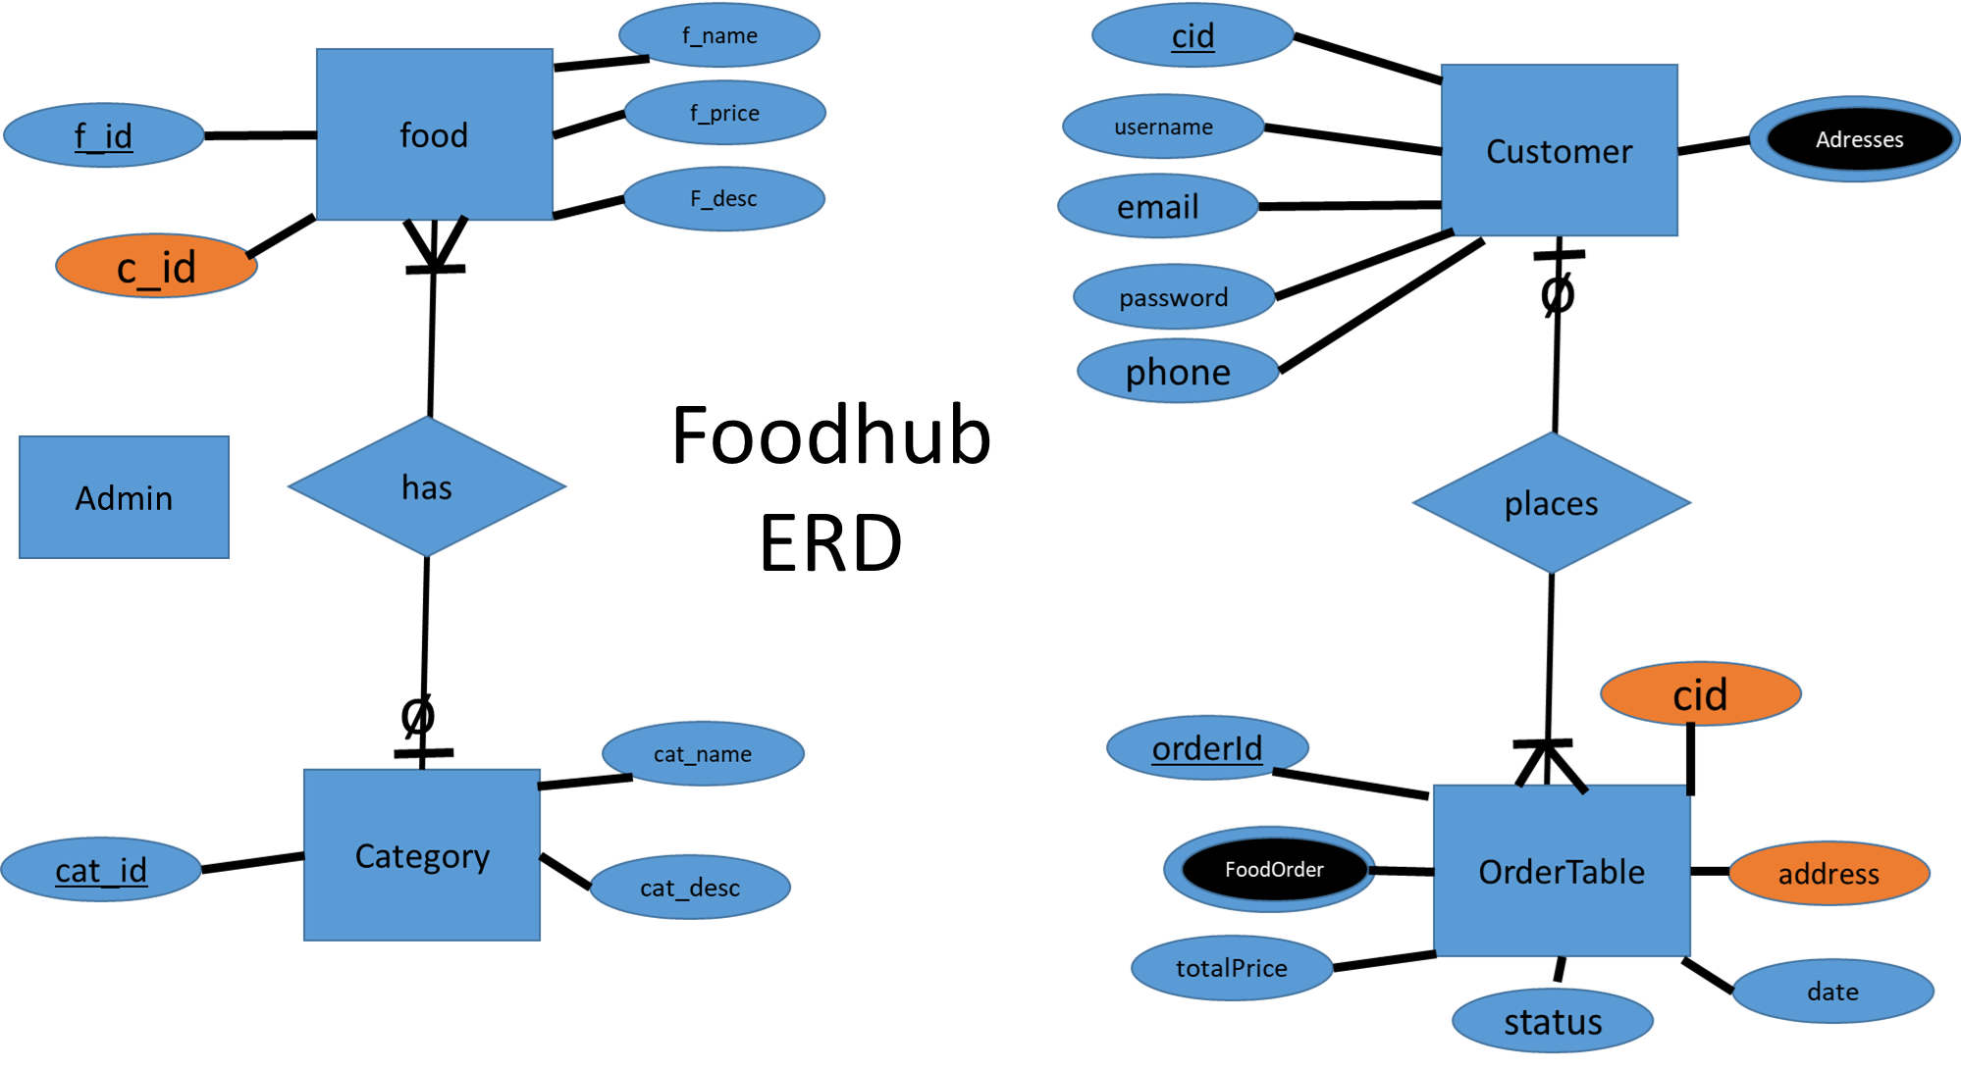

Slide 5
ADMIN
Add/Delete a Category
CATEGORY
Get all Categories
Add/Delete a Food
Getting order details
Changing status
Category
Get all Food
ORDER
FOOD
Get Categories
Get Food
Place , changing status
Get order details
Add Address
Address
CUSTOMER
Get Addresses

Slide 6
Customer app Front-End

Slide 17
Few Apis and query to access database

Slide 18
This api checks if your already exist or not

Slide 19
This api fetches menu

Slide 20
This api record user’s address

Slide 21
This api getches recipt of orders

Slide 22
Admin app Front-End

Slide 29
Few Apis and query to access database

Slide 30
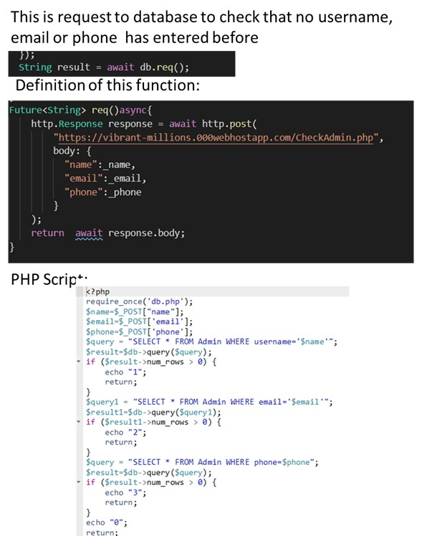

Slide 31
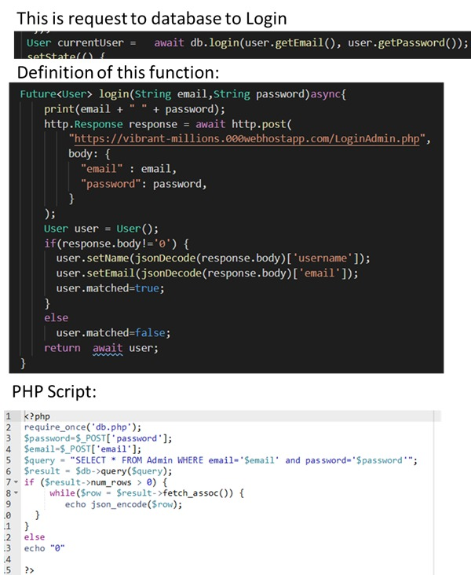

Slide 32
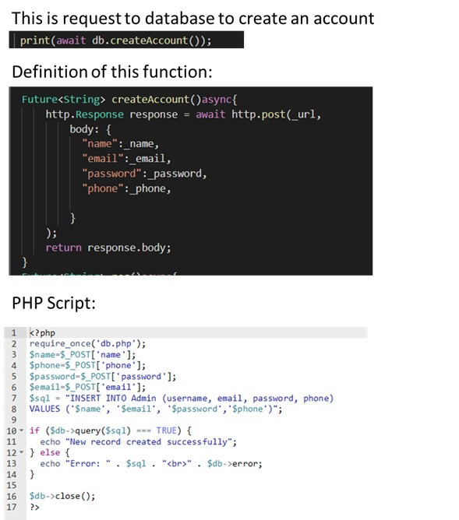

Slide 33
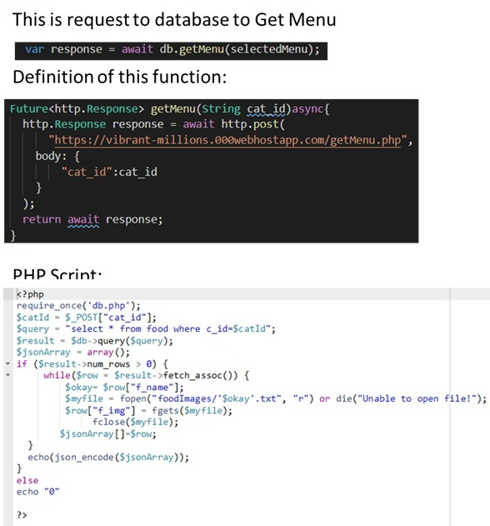

Slide 34
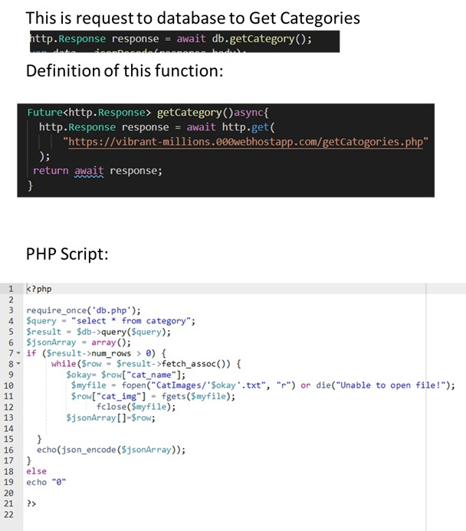

Slide 35
Thanks

